Slide 1
Accelerated Math Presentation
Warm Springs Middle School

Slide 2
New MVUSD Math Pathways
Notes:
(Current 7th graders)
Towards the tail end of last year the district created the new accelerated pathways leaving us little to no time to get the ADV. kiddos to where they needed to be in order to be ready for the accelerated path. We held a parent meeting toward the end of last school year explaining to parents the need for their son/daughter to complete lessons over the summer if they were choosing to take the accelerated class. At the meeting we explained that teachers would not have the time to do any review and that the kids would need to learn prescribed standards over summer break.
(Current 6th graders)
Last years 5th graders is a completely different issue and a learning curve for us. I fully apologize and take ownership of the breakdown in communication from the start. We thought it was going to be easy to just look at a few scores and recommendations, but Looking back we should have held parent meetings for all of our incoming 5th grade students/parents.

Slide 3
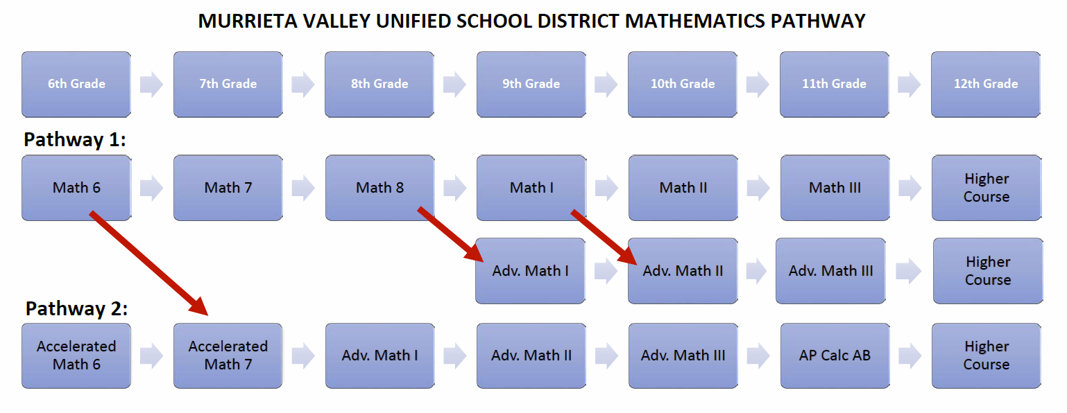
6th Grade + Half of 7th Grade
Half of 7th Grade + 8th Grade
ADV. 9th Grade Standards

Slide 4
Accelerated and Advanced are very different. Students can score advanced on the CAASPP, but not have the ability to be self-driven and self-motivated to adapt to the accelerated class and learning more than one year's worth of standards.

Slide 5
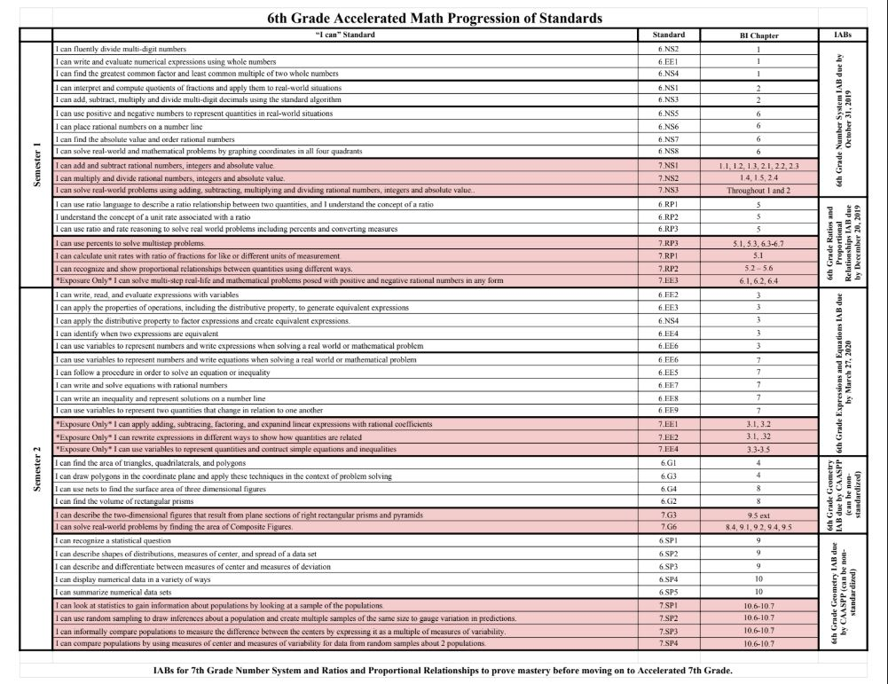
6th Grade Standards (White) + ½ of 7th Grade Standards (PINK)
In order to complete the required standards (1.5 years worth of curriculum), teachers must continue at a fast pace in the Accelerated 6 and Accelerated 7 Math course.
Notes:
Up until this point, teacher have been attempting to accommodate the needs of ALL students, however, the pace has been slowed down and we are not on track for completion.

Slide 6
Things to keep in mind
Is your student willing to work outside of class time to keep up with this pace?
Does your student participate in additional activities in/out of school that may add additional stress for him/her?
A “D” or an “F” in an Accelerated course will negatively impact your students’ GPA which could impact their chances of achieving honor roll status
If your son or daughter is currently receiving a grade of a "C" or lower that could be an indicator of future struggle
Talk to your student about how they are feeling…

Slide 7
Next Steps
Teachers will be in contact with you if there are concerns with your student’s progress.
If you feel that this course is not the best place for your student or you would like to discuss your individual situation, please fill out a half sheet with the counselors in the back of the MPR.

Slide 8
Thank You

